Slide 1

Dynamic Coupon Targeting Using Batch Deep Reinforcement: An Application to Livestream Shopping
Luxuan Liu, Zhongyuan Zhou
School of Hotel and Tourism Management, CUHK Business School
March, 2026

Slide 2

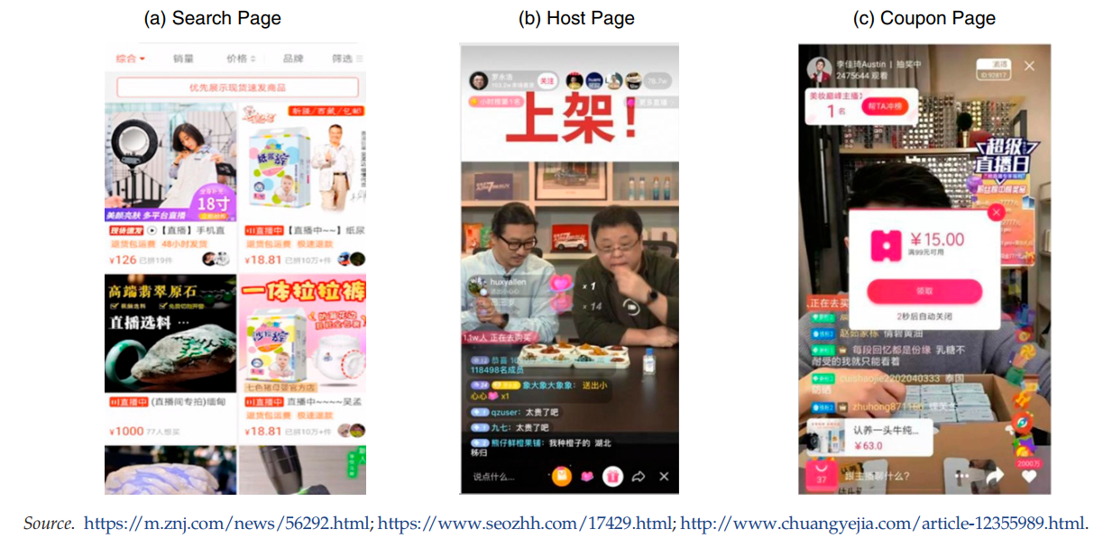
Dynamic coupon in the e-commerce era
Liu, X. (2023). Dynamic coupon targeting using batch deep reinforcement learning: An application to livestream shopping. Marketing Science, 42(4), 637-658.
Dynamic and personalized pricing improves market efficiency.
To maintain fairness and customer trust, firms often use personalized coupons instead of direct price discrimination.
Digital coupon redemption is projected to grow from $47B (2017) to $91B (2022).
Notes:
First, let me briefly introduce the background of this study.
With the rapid growth of livestream shopping, firms increasingly rely on dynamic and personalized pricing strategies to influence consumer purchases
For companies, dynamic and personalized pricing can improve market efficiency, because firms can better match promotional offers with consumers who are more likely to respond.
However, directly charging different prices to different consumers may raise concerns about fairness and trust. To avoid this issue, many platforms adopt personalized coupons instead of price discrimination. In other words, consumers may receive different coupons, but the listed product price remains the same.
The use of digital coupons has been growing very rapidly. For example, the total value of digital coupons increased from about 47 billion dollars in 2017 to 91 billion dollars in 2022.
So this paper studies how an e-platform can dynamically target coupons to consumers in the context of livestream shopping, using a batch deep reinforcement learning approach.

Slide 3
Research questions
Technical challenges
Unknown demand dynamics: optimal coupon strategy is hard to determine.
Prediction challenge: avoid bias from parametric models.
High-dimensional targeting: large consumer and contextual feature space.
(1) How can we develop a theoretical framework that incorporates the intertemporal tradeoffs in dynamic coupon targeting to design a policy that maximizes revenue?
(2) How can we evaluate the performance of dynamic coupon targeting policies?
(3) What are the gains, if any, from using a dynamic targeting framework relative to a static benchmark, and what explains the differences in performance?
Solution
Developing a framework to design and evaluate dynamic personalized pricing strategies: a model-free, batch deep reinforcement learning (BDRL) algorithm
Notes:
Basically, how can we design a model that decides which coupon to send while considering both current and future revenue. The second question is how to evaluate whether a dynamic coupon targeting policy actually performs well.
The third question is whether dynamic targeting actually generates better outcomes compared with a simple static strategy

Slide 4
Previous ideas
Three dynamic effects of price promotions on demand
Model-Based vs. Model-Free
Reinforcement Learning
Reference price Past prices shape expectations
Strategy: low → high discounts.
Loyalty / inertia Past purchases increase repeat behavior. Strategy: high → low discounts.
Variety-seeking Consumers switch after purchase due to satiation. Strategy: stable, low discounts
Structural models:
Predict behavior with parametric assumptions → flexible but prone to model bias.
Reinforcement learning
Learn optimal policies from data directly → avoids misspecification and handles high-dimensional environments.
Notes:
To design effective dynamic coupon strategies, the paper draws on insights from the dynamic pricing literature, which highlights three key behavioral effects.
The first is the reference price effect. Consumers form price expectations based on past promotions. So if discounts increase over time, consumers may perceive later discounts as more attractive.
The second is loyalty or inertia. After making a purchase, consumers may be more likely to buy again from the same platform. In this case, firms might use high discounts initially to attract customers and then reduce the discounts later.
The third is variety-seeking. After purchasing, consumers may want to try different products, so changing discounts may not be necessary. A stable and relatively low discount strategy could be sufficient.
Traditional structural models try to predict consumer behavior using parametric assumptions about preferences. These models can be flexible and interpretable, but they may suffer from model misspecification if the assumptions are wrong.
In contrast, reinforcement learning takes a more data-driven approach. Instead of specifying the behavioral model directly, it learns the optimal coupon policy from data, which helps avoid model bias and works well in high-dimensional environments, such as large e-commerce platforms.

Slide 5
Data patterns
Consumer behaviors:
Summary Statistics
🔍
Browse livestream channels
We collect data on 1,020,898 consumers during three
months in 2019. These consumers received 25,886,094
coupons and completed 1,539,424 transactions while
watching 200,568 distinct livestreams, created by 11,926
hosts.
▶️
Enter a channel and interact
💸
Receive and claim coupon
All consumers in the data set were “active,”
which the platform defines as receiving at least 10 coupons during the sample period.
❌
Exit channel (coupon expires)
Notes:
The typical consumer performs the following sequence of actions Browse channels Consumer lands on the search page and browses livestream thumbnails ranked by an algorithm.
Enter a channel Consumer clicks a channel to watch the livestream and interact with the host (e.g., chat, add to cart, purchase).
Receive a coupon A discount coupon pops up during the session; the consumer can claim and use it before leaving.
Exit the channel Consumer leaves the livestream and returns to the search page; the coupon becomes invalid after exit.

Slide 6
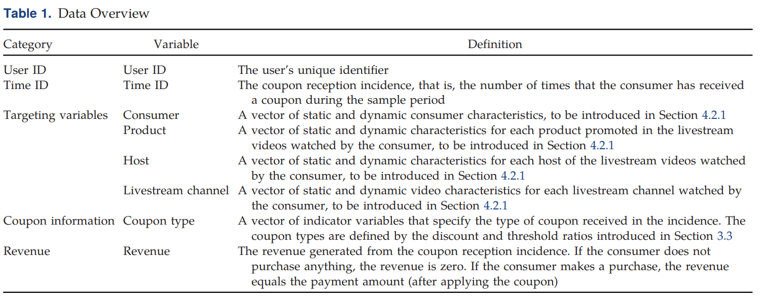
Data patterns
Coupon Effect
Example coupon: “¥15 off ¥99”
Discount ratio (ratio of the discount value to the threshold value)
Threshold ratio (ratio of the threshold value to the average price in the livestream)
Five levels: LL (extra low), L (low), M (middle), H (high), and HH (extra high)
Assume the average livestream product price = ¥120
Discount Ratio = 15 / 99 = 15.15%
Threshold Ratio = 99 / 120 = 82.5%
Notes:
discretize both variables to five levels: LL (extra low), L (low), M (middle), H (high), and HH (extra high), based on the quintiles in their distributions

Slide 7
Data patterns
Model-Free Evidence
Intertemporal Tradeoffs
Consumer-level heterogeneity in the effectiveness of coupons
Intertemporal tradeoffs in the impacts of the coupon strategy between the current period and future periods
Reference Price
High discounts boost short-term sales but may reduce future responsiveness
State Dependence (Loyalty/Inertia and Variety Seeking)
Heterogeneity in Sensitivity to Discounts
Consumer purchase decisions appear independent across periods in this setting.
High spenders: low discounts generate higher revenue
Low spenders: high discounts are more effective.
→ Coupon strategies should be personalized across consumers
Forward-Looking
No evidence of forward-looking behavior in the data.
Notes:
For high spenders (top 10% in spending), low-discount coupons generate higher revenue than high-discount coupons, suggesting they are less price-sensitive.
For low spenders (bottom 10%), high-discount coupons generate more revenue, indicating stronger price sensitivity and a greater need for deeper discounts to motivate purchases.
Three types of demand dynamics ：
Reference Price Effect
Consumers use past discounts as reference prices, which shapes their response to future promotions.
Higher discounts today increase current redemption but lower future responsiveness, while lower discounts today can increase future redemption.
State Dependence (Loyalty / Variety-Seeking)
State dependence suggests that past purchases may influence future purchase behavior (loyalty or variety-seeking).
However, the data show no significant state dependence: purchasing in the previous period does not affect the likelihood of purchasing in the next period.
A possible reason is low product loyalty in livestream shopping categories (e.g., apparel and cosmetics).

Slide 8
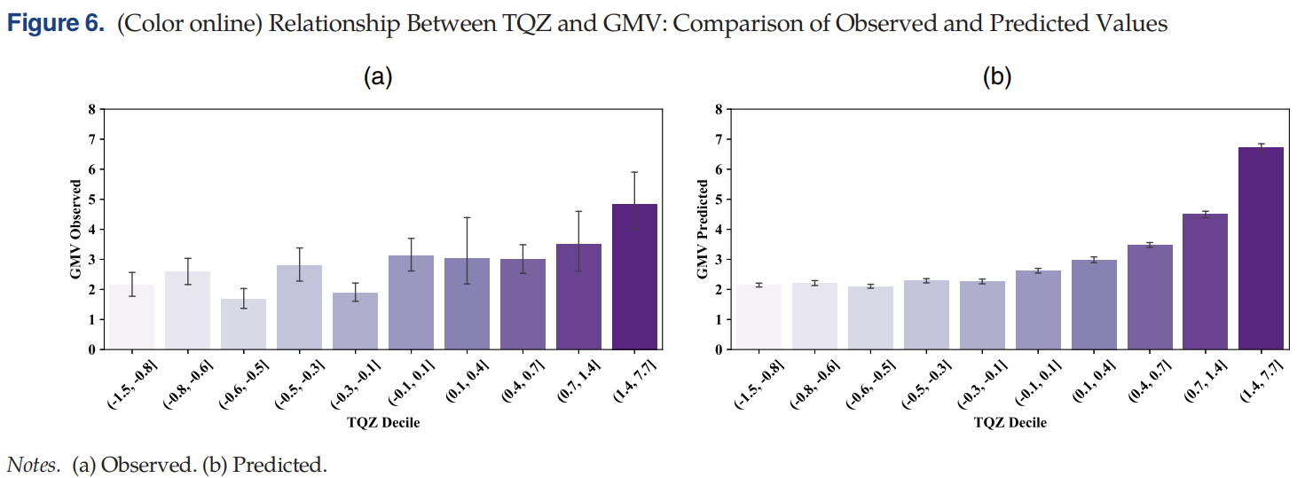
Data patterns
Model Bias
TQZ–GMV Relationship and Model Bias
Observed data show a non-monotonic relationship between TQZ and GMV.
However, GBDT predicts a monotonic pattern, indicating model misspecification.
Such bias may lead to suboptimal policy decisions.
Implication
Use a model that captures consumer heterogeneity and intertemporal trade-offs.
This study adopts model-free Batch Deep Reinforcement Learning (BDRL).
Notes:
Next, the paper highlights the issue of model bias when modeling consumer behavior in complex shopping environments.
For example, the paper examines the relationship between consumer activity level (TQZ) and gross merchandise value (GMV). In the observed data, this relationship is non-monotonic, meaning it fluctuates across activity levels.
However, a common machine learning model, GBDT, predicts a monotonic pattern, which does not match the actual data. This suggests that traditional models may be mis-specified, which could lead to suboptimal policy decisions.
Therefore, the paper argues that we need a model that can capture consumer heterogeneity and intertemporal trade-offs while avoiding strong assumptions. To address this, the study adopts a model-free Batch Deep Reinforcement Learning approach.

Slide 9
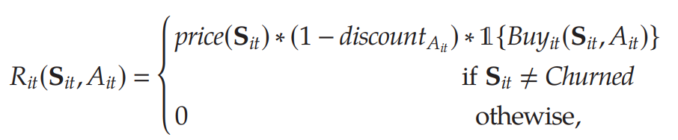
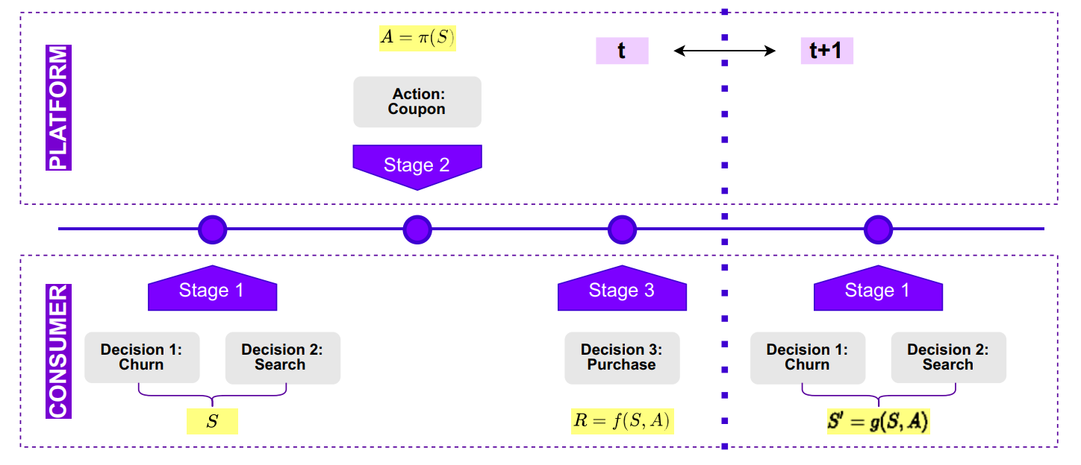
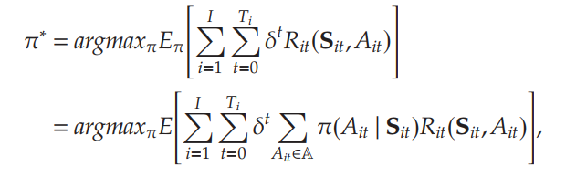
Model
Generalizability of the Setting
Problem: Platform chooses which coupon 𝐴𝑖𝑡​ to send to consumer 𝑖 at visit 𝑡, based on context 𝑆𝑖𝑡​, to maximize purchase probability.
Stage 1: Consumer decides churn or search → defines state S.
Stage 2: Platform sends coupon/price (action A).
Stage 3: Consumer decides purchase → reward (GMV).
Repeat over time (t → t+1) and optimize with BDRL.
Reward (Revenue) per visit:
Find optimal targeting policy 𝜋∗ to maximize expected total discounted GMV:
Structural Model Sequence of Events
Notes:
Stage 1 – Consumer Decisions
Consumers decide whether to churn or stay, and then search for products.
These decisions determine the shopping context (state S).
Stage 2 – Platform Action The platform chooses an action (coupon) based on the current state.
Stage 3 – Purchase Decision Consumers decide whether to purchase, generating the reward (GMV).
Dynamic Process The process repeats across periods (t → t+1), updating the consumer state.
Next they show the core idea of our model: every time a consumer visits a product page, the platform decides which coupon to send. Each coupon can increase the chance of purchase but may reduce the payment amount, which we capture in the revenue-per-visit formula. The goal of the model is to find the optimal policy that maximizes the total expected revenue across all consumers and over time, taking into account a discount factor for future rewards.

Slide 10
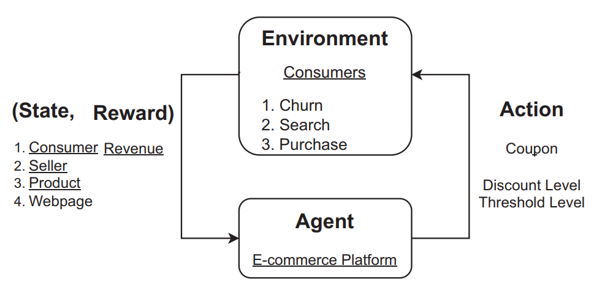

Model
State (S): Context information: consumer, seller, product, webpage
Action (A): Coupon selection
Reward (R): GMV from purchase influenced by coupon
Objective: Maximize total discounted reward (return) over time:
Reinforcement Learning Framework
Notes:
Based on this, they build the reinforcement learning framework. Next, my teammate will share the details of how this framework works and the empirical results.

Slide 11
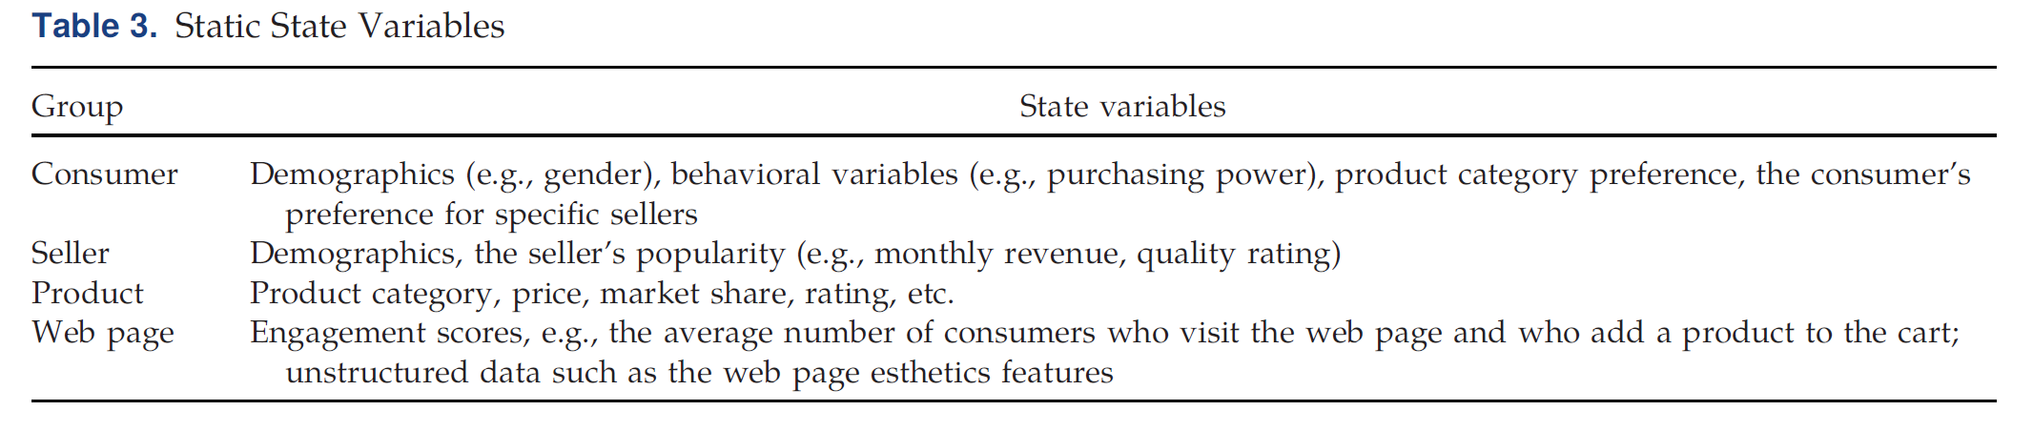
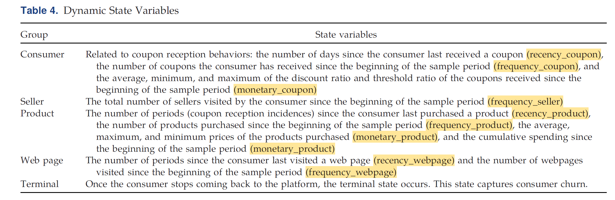
Model
State (S):
Static States
Dynamic States
Notes:
The states include Static States and Dynamic States
Static states such as demographics of consumers, basic characteristics of the sellers, and product categories
The dynamic state is constructed according to the classic RFM framework: R is Recency, which is how long since the last behavior.
F is Frequency, indicating the cumulative number of occurrences.
M stands for Monetary, which includes cumulative amounts, average prices, historical coupon magnitudes, etc.
This is because consumers will remember past discounts. Therefore, the author has placed the average, maximum and minimum discount rates of past coupons into a dynamic state, which is equivalent to encoding the "psychological reference price" into the state

Slide 12
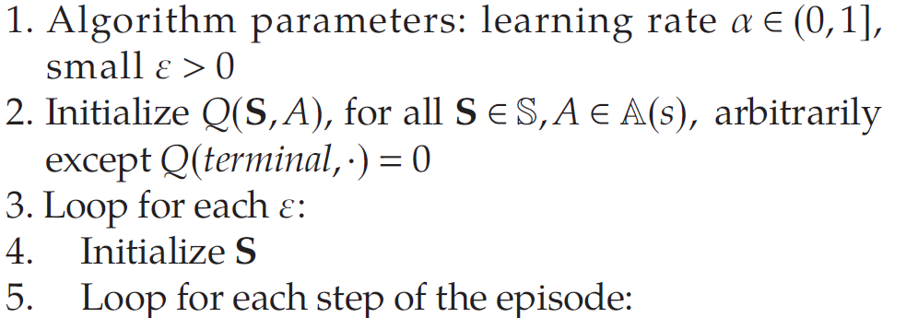
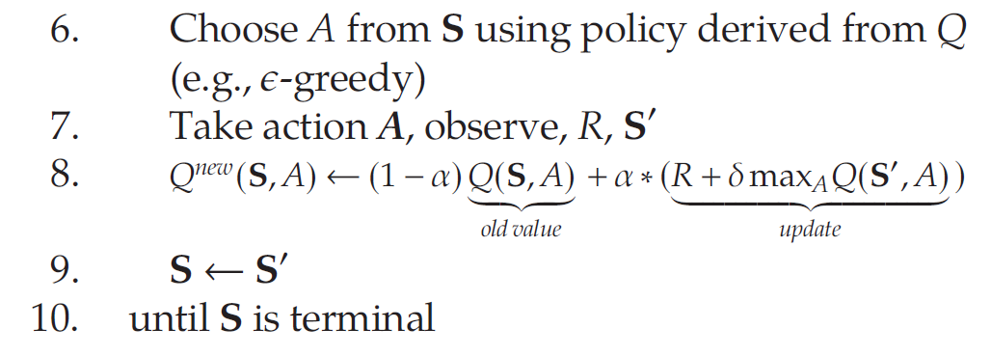
Model
Policy Learning
Algorithm 1 (Q-learning):
Before learning begins, Q is initialized to a
possibly arbitrary fixed value
At each time the platform selects an action (A), observes a reward (R) and a new state (S’)
Given the new reward (R) and new state (S’), Q is updated to Q^{new} using a weighted average of the Q value from the previous iteration and the new information [α = learning rate, δ = discount factor].
Notes:
To solve the MDP problem, we use the batch-constrained Q-learning algorithm. “Q-learning” involves a function that calculates the total discounted rewards used to provide the reinforcement feedback in the learning process. Q-learning is model-free because it does not rely on any functional form assumptions about the reward function or the state transition function. It uses samples collected in the historical data to directly observe the reward and the next state.
The original Q-learning algorithm is appropriate when the state and action spaces are small. But, with continuous state values, we cannot expect to find an optimal value function within the limit of infinite time and data. Instead, the value function needs to be a parameterized function, they choose DNNs as the functional approximator.

Slide 13
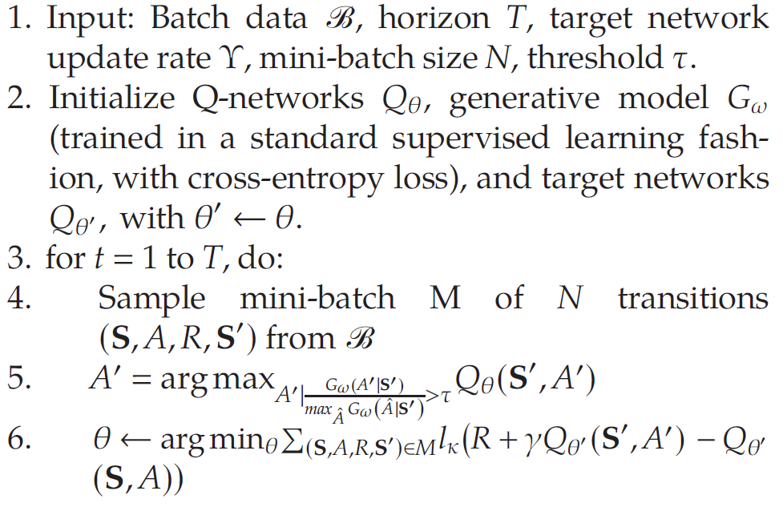
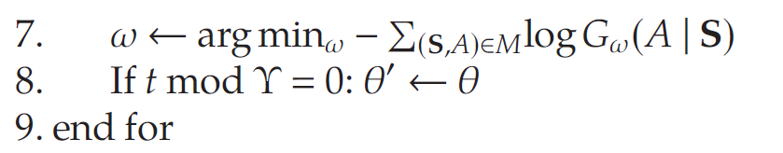
Model
Policy Learning
Algorithm 2 (batch-constrained Q-learning, BCQ):
Adjust a threshold value (τ) for a state-action pair and allow only the actions whose relative probability is above the threshold.
The probability of actions in each state is calculated by training a generative model (G_{ω,} GBDT model)
Notes:
Another important feature of our solution is that we use batch reinforcement learning. But batch reinforcement learning algorithms have been shown to be susceptible to extrapolation error. This is because When selecting action A, such that the pair (S,A) is distant from the data contained in the batch, the estimate Q(S,A) may be arbitrarily poor. We address this problem by using a BCQ algorithm

Slide 14
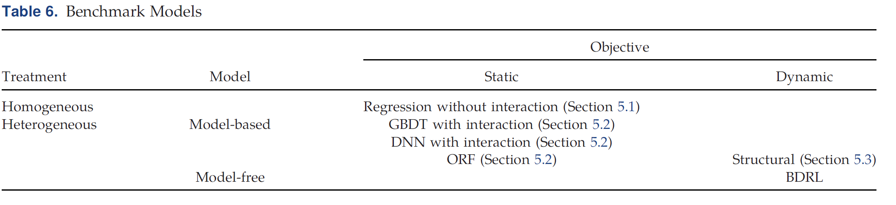
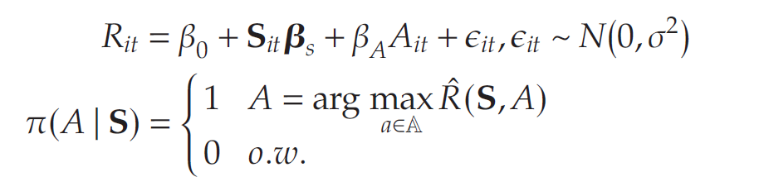
Benchmark Policies
We estimate the value of the new policy using the doubly robust estimator:
Regression without interaction:
model = LinearRegression(fit_intercept=False)
Static Policy with Heterogeneous Treatments:
Indirect methods: GBDT and DNN
Direct methods: ORF
Notes:
To generate the static homogeneous treatment policy benchmark, we use a linear regression without the interaction between states and actions (Section 5.1). We generate the static heterogeneous treatment policy benchmarks using three alternative models: GBDT, DNN, and ORF. We generate the dynamic heterogeneous treatment policy using a structural approach (Section 5.3). Finally, BDRL is the model-free dynamic heterogeneous treatment approach (Section 4.2).
Regression without interaction:
Without distinguishing between people or considering the future, I just want to find a coupon that is "the most profitable on average".
That is to say, the system will ask:"In this current exposure, which coupon is the most suitable for this user?"But it will not ask:"If I give this coupon today, will it increase the user's reference price tomorrow and thereby harm the subsequent conversion?“
The role of this benchmark is to provide an optimized control group with the lowest threshold
Static Policy with Heterogeneous Treatments:
Direct: For the current state of a certain user, you ask the model to predict:• The revenue generated when issuing a low/medium/high discount coupon.
Indirect: They do not first fit a predictor of "state + action → benefit", but directly estimate the heterogeneous processing effect of each action, and then take the action with the highest processing effect as the optimal action

Slide 15
GBDT
class gbdt_model(object): def __init__(self, num_state_var, num_action): ''' :param num_state_var: int Number of state variables :param num_action: int Number of action types ''' self.num_state_var = num_state_var self.num_action = num_action def train(self, states, action, rewards, param_grid, prediction,file_name): ''' Data be train+validation dataset Use gridseachCV to search on the best hyperparameters and return model :param states: array-like, shape (n_samples, num_state_var) states features :param action: array-like, shape (n_samples, num_action) action features :param rewards: array-like, shape (n_samples) rewards target :param param_grid: dict (from live_config) hyperparameter for gridseach to search on :param prediction: type of prediction to make :return: the best GBDT model and save '''

Slide 16
DNN
class BaselineNNInstance25Models(object): def __init__(self, num_state_var, num_action, dropout_rate=0.2): ''' Parameters ---------- num_state_var: int Number of state variables num_action: int Number of action types dropout_rate: float, default 0.2 Dropout rate used in FC layers ''' # input_dim = num_state_var + num_action self.model_list = [BaselineFCStates(num_state_var, dropout_rate) for _ in range(num_action)] self.device = 'cuda:0' if torch.cuda.is_available() else 'cpu' # self.model.to(self.device) self.num_state_var = num_state_var self.num_action = num_action def loadWeights(self, model_path): ''' Load saved weights into model ''' for i, m in enumerate(self.model_list): m.load_state_dict(torch.load('{}/nn_action_{}.pt'.format(model_path, i))) print('Weights loaded from {}'.format(model_path)) def saveWeights(self, model_path): ''' Save weights ''' for i, m in enumerate(self.model_list): torch.save(m.state_dict(), '{}/nn_action_{}.pt'.format(model_path, i)) print('Weights saved to {}'.format(model_path))

Slide 17
ORF
class ORF_model(object): def __init__(self, input_data): ''' :param input_data: Data of the format in each row < USERID, TIMEID, State, Action, NextState, Reward > ''' self.input_data = input_data def train(self): ''' Return: trained ORF model ''' # Make model inputs X = self.input_data[:, 2:live_config.num_state_var+2] #X = self.input_data[:, 2].reshape(-1, 1) Y = np.ravel(self.input_data[:, -1]) T = self.input_data[:, live_config.num_state_var+2:live_config.num_state_var+live_config.num_action+2] T = np.where(T==1)[1].reshape(-1, 1) for a in [X,Y,T]: print(a.shape) print(type(a)) est = DMLOrthoForest( n_trees=live_config.num_trees, max_depth=live_config.max_depth, min_leaf_size=live_config.min_leaf_size,

Slide 18
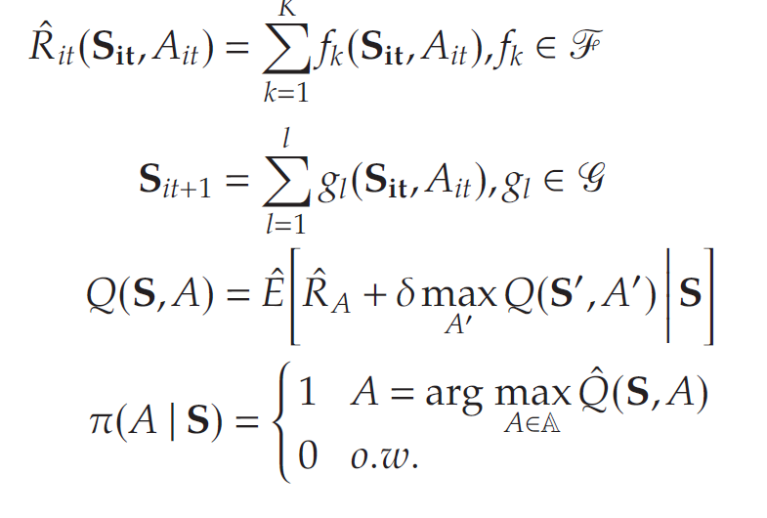
Benchmark Policies
Dynamic Policy with Heterogeneous Treatments: Structural Model
function f for the reward
function g for the state transition process
policy-specific value function
Optimal policy is the one that maximizes the Q function
Notes:
address the issue that :Current actions will affect future states and future reward.
5.3 is the key benchmark for answering the question of whether to adopt model-free or not. If BDRL only won 5.1 and 5.2, you still cannot prove that "model freedom" is valuable. It can only demonstrate that "even if you have done dynamic structural optimization, you may still lose to Model-free RL due to model bias" after going beyond 5.3.

Slide 19
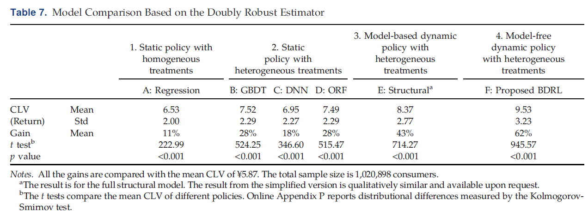
Benchmark Policies
Notes:
At the first level, the static homogeneous strategy is better than random, indicating that "optimization" is valuable in its own right. The linear regression policy is 12% higher than the original random issuance.
At the second level, the static heterogeneity strategy is again stronger than the static homogeneity strategy, indicating that personalization has value. GBDT, DNN and ORF are all higher than homogeneous regression, which reflects that "issuing different coupons for different people" is better than "one size fits all.“
At the third level, the dynamic structural model further increases the gain to 43%, indicating the value of intertemporal dynamics. That is, couponing cannot look only at current conversions, but also at its impact on future responses.
At the fourth layer, BDRL pushes the gain to 62-63%, indicating that in this high-dimensional and strong dynamic scene, the combination of dynamic + personalized + model freedom is better than the dynamic structural model.

Slide 20
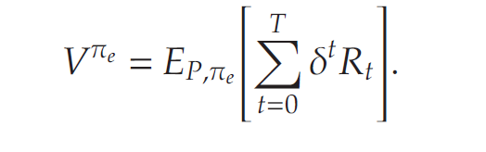
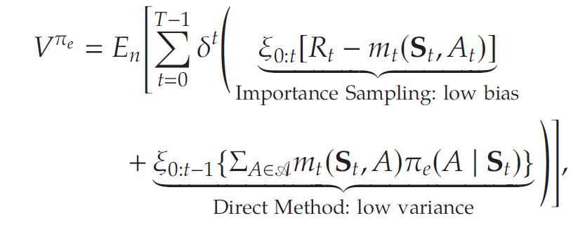
Evaluation
In-Sample Policy Evaluation
Given a new policy (π^{e}), we want to calculate the value function associated with this policy:
We estimate the value of the new policy using the doubly robust estimator:
The reward actually observed - the reward predicted by the model
If the new strategy reaches this state, how much reward will it receive?
Notes:
The value function is the long-term discounted total return brought about by the entire strategy, It can also be regarded as the net present value of customers or customer lifetime value,
Combines IPS and direct method

Slide 21
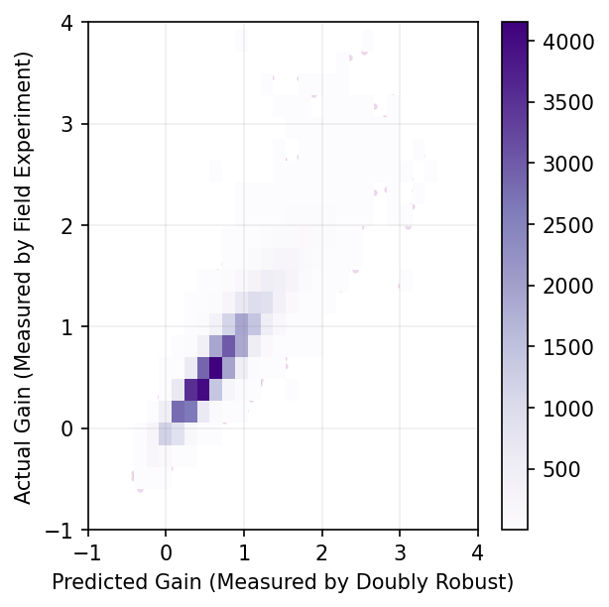
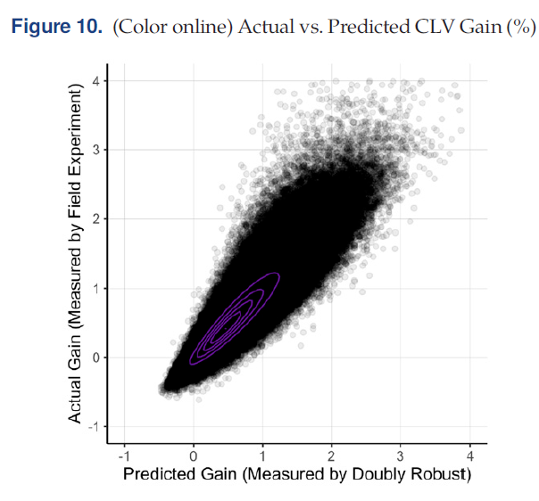
Evaluation
replication
original
Notes:
The value function is the long-term discounted total return brought about by the entire strategy, It can also be regarded as the net present value of customers or customer lifetime value,
Combines IPS and direct method

Slide 22
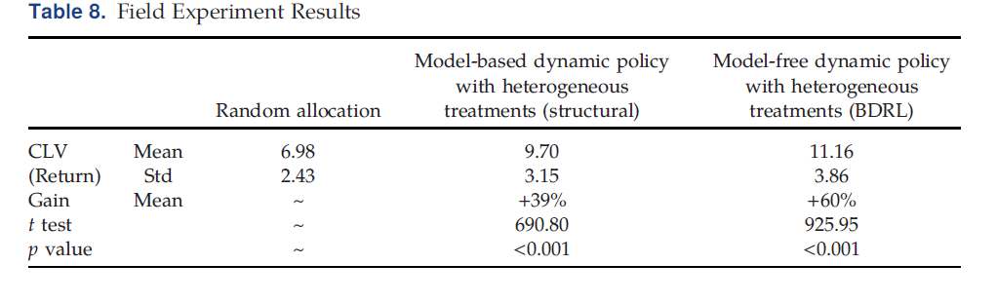
Evaluation
Out-of-sample evaluation
Field Experiment:
Notes:
The value function is the long-term discounted total return brought about by the entire strategy, It can also be regarded as the net present value of customers or customer lifetime value,
Combines IPS and direct method

Slide 23
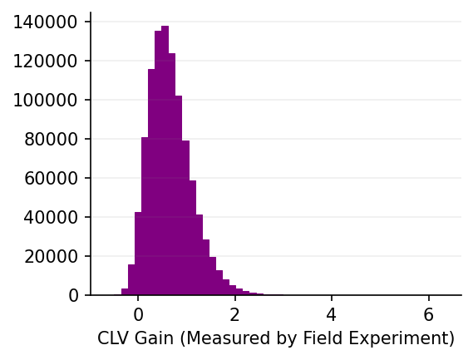
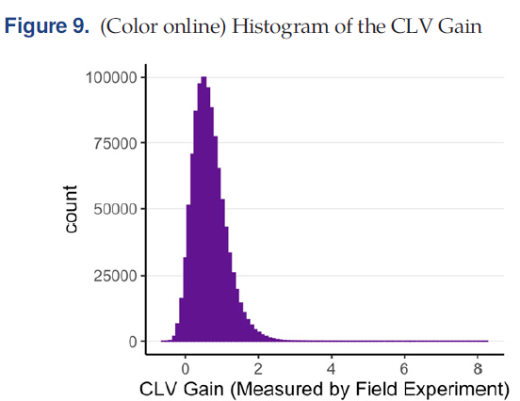
Evaluation
replication
original
Notes:
The value function is the long-term discounted total return brought about by the entire strategy, It can also be regarded as the net present value of customers or customer lifetime value,
Combines IPS and direct method

Slide 24
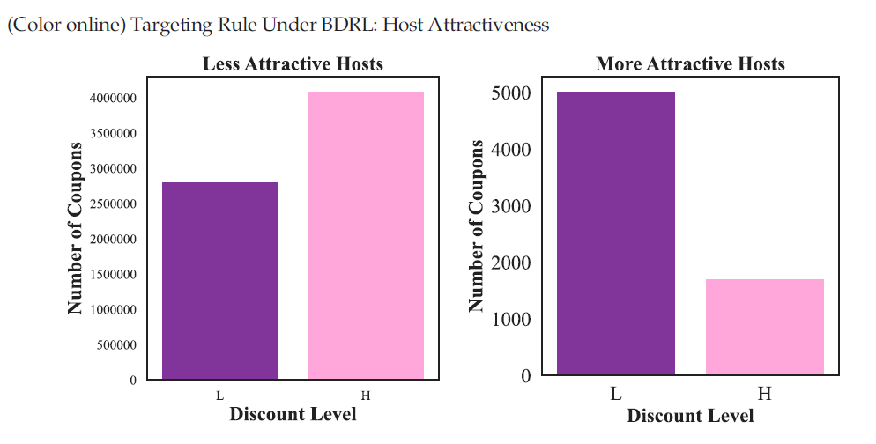
Targeting Rules
Whom to Target
For sellers with low attractiveness, issue high discount coupons;
For sellers with high attractiveness, issue low discount coupons.
compensatory effect
Notes:
The previous proof is "BDRL is more effective", but the explanation here is "what does it learn“
consumers get more utility per se from more attractive sellers, so they need less monetary compensation; When the attraction is low, it is necessary to make up for it with a higher discount

Slide 25
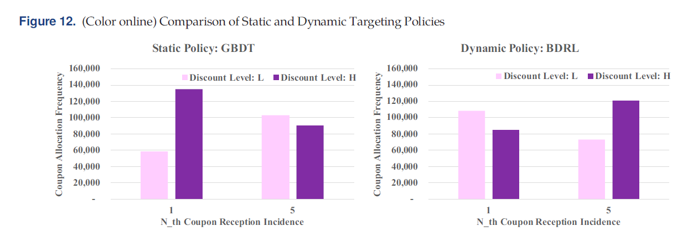
Targeting Rules
When to Target
For new users, GBDT more often recommends high discounts
BDRL is more likely to recommend lower discounts for new users
BDRL recommends that discounts increase gradually with user experience.
Reference price effect
Notes:
If you give new users a big discount at the beginning, they will use that low price as a reference point and will not respond to the general discount in the future. Therefore, the dynamic policy is more conservative, choosing a "small first and then large" price skimming path.
This is precisely one of the most important dynamic insights of the paper.The reason why the static model only looks at whether the high discount in the current period leads to higher conversion; BDRL is stronger because it knows that "being too generous today makes it harder tomorrow."

Slide 26
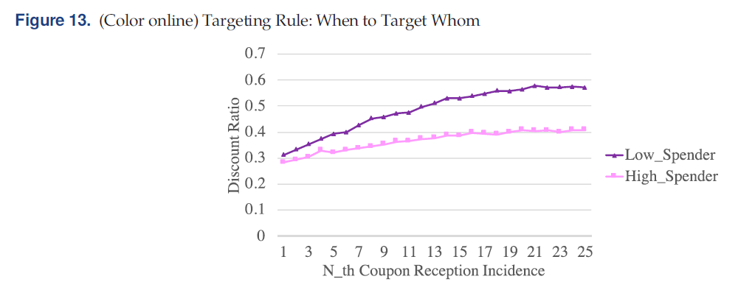
Targeting Rules
When to Target Whom
Low-spending users get slightly higher discounts to begin with;
Discounts rise faster for low-spending users as they gain experience;
Higher spending users have a flatter discount path.
Notes:
Low-spending users are more price sensitive and therefore require larger discounts, which increase more quickly over time in order to maintain engagement.This rule is important because it shows that BDRL is not simply stacking two rules: "Whoever is sensitive gives more" and "the longer the discount is greater", but learning a finer function:Different types of consumers have different optimal discount ascending paths.

Slide 27
Conclusion and Future Directions
Conclusion:
Compared with the benchmarks, BDRL can increase the GMV of the platform by more than 60%, indicating that this method is particularly suitable for high-frequency and high-dimensional e-commerce pricing problems
Dynamic coupons should not only look at current conversion, but also consider consumer heterogeneity and time dynamics.
The advantage of BDRL is that it can automatically identify “whom to target, when to target, when to target whom"
Limitation:
Assumes that consumers are not forward-looking because there is no relevant evidence observed in historical data;
Mainly relies on observable characteristics and only studies "active users";
Future research:
examine whether the optimal pricing path changes when consumers wait for a greater discount.
partially observable MDP or multiagent RL can be considered to deal with unobserved heterogeneity and test whether the conclusions are applicable to low or inactive users.
Notes:
Low-spending users are more price sensitive and therefore require larger discounts, which increase more quickly over time in order to maintain engagement.This rule is important because it shows that BDRL is not simply stacking two rules: "Whoever is sensitive gives more" and "the longer the discount is greater", but learning a finer function:Different types of consumers have different optimal discount ascending paths.

Slide 28
Thanks!

